Slide 1


MPMC PROJECT Team-8
Password based door lock system

Slide 2


Contents
Introduction
Components Required
Circuit Diagram
Block Diagram
Embedded C code
Team Members
Conclusion

Slide 3
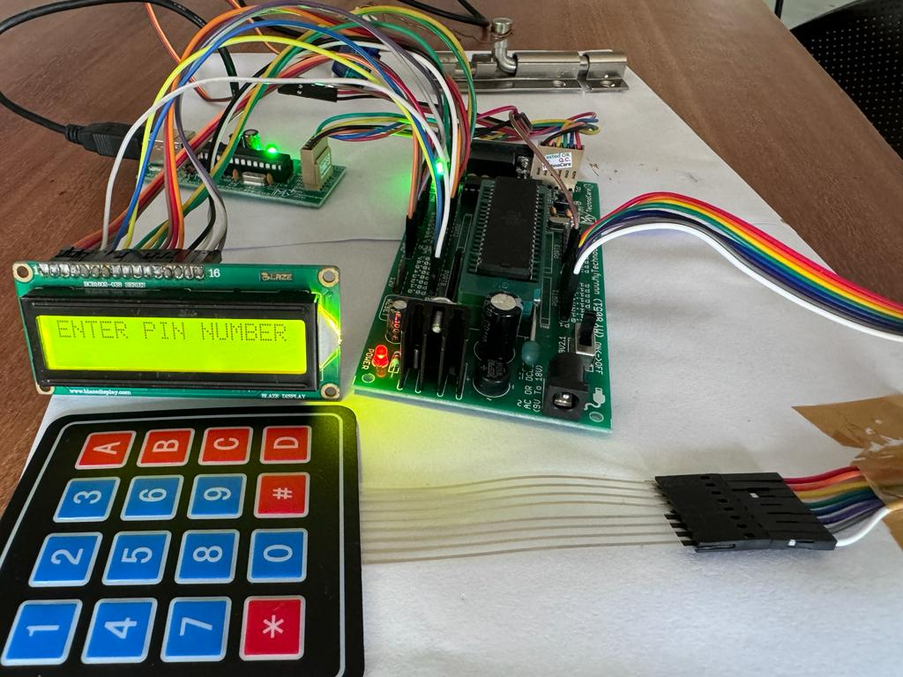
Introduction
The password-based lock system can install any door of any rooms. This system also can be integrated with the existing system. This electric combination lock system uses a five-digit password.
The system collects five-digit user input and compares the user input with the preset password inside the program. If the password matches, access will be granted, and if not match the entry will be denied.
The system can be used at residential places to ensure better safety. It can be used at organizations to ensure authorized access to highly secured places.

Slide 4
Components Required
8051 Microcontroller
Servo Motors
Connecting Wires
Phone Keypad
LCD-LM016L
Keil Software

Slide 5
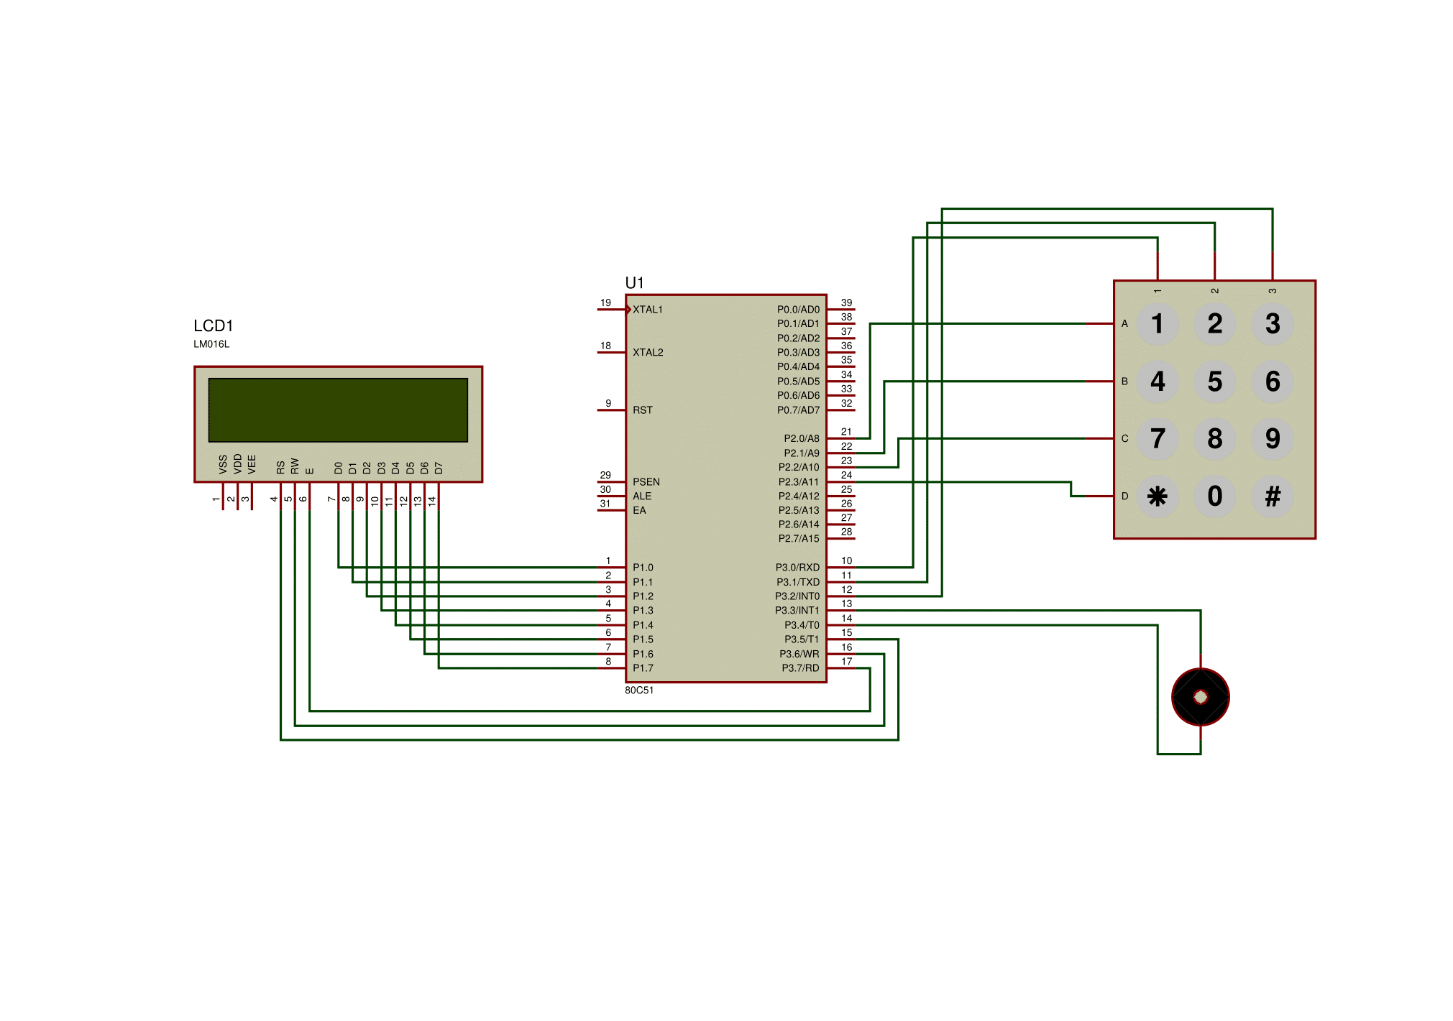
Circuit Diagram

Slide 6
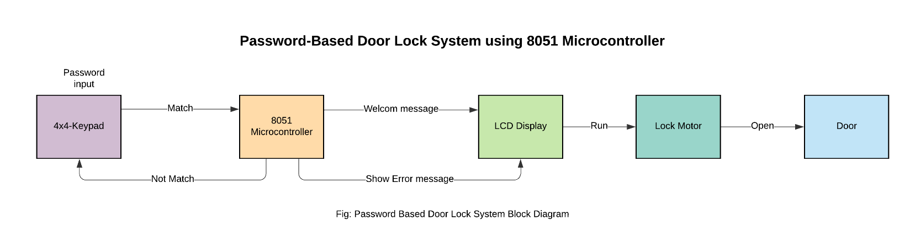
Block Diagram
Servo Motor

Slide 7
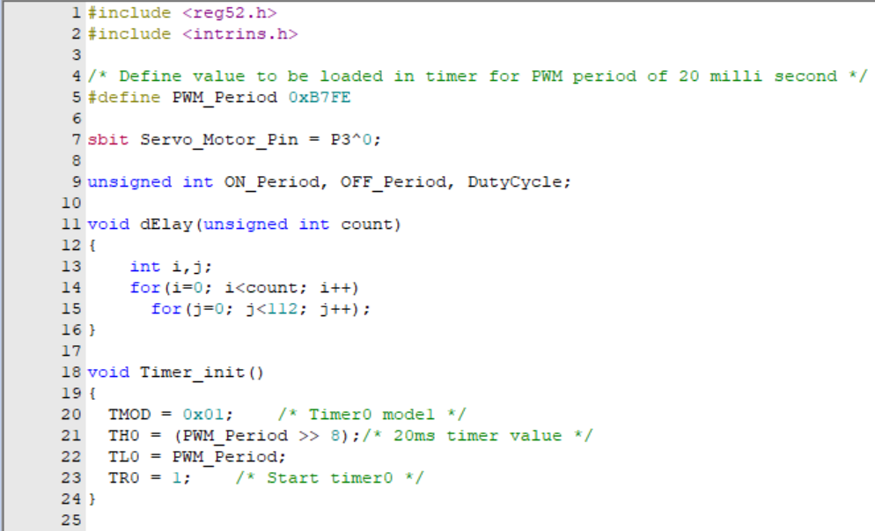
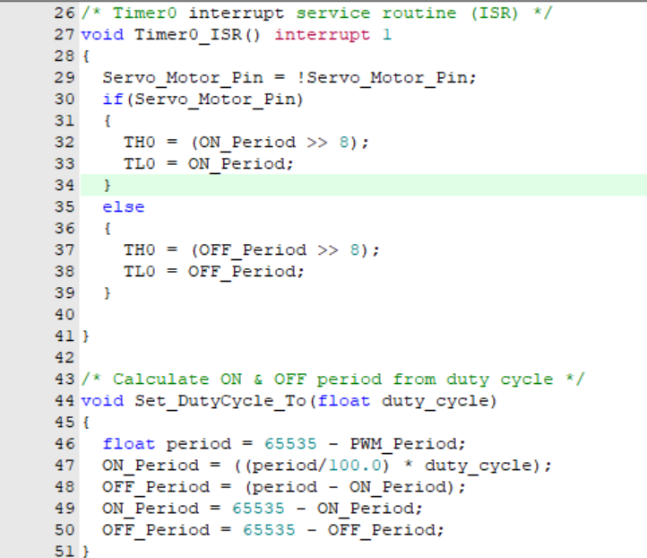
Embedded C Code

Slide 8
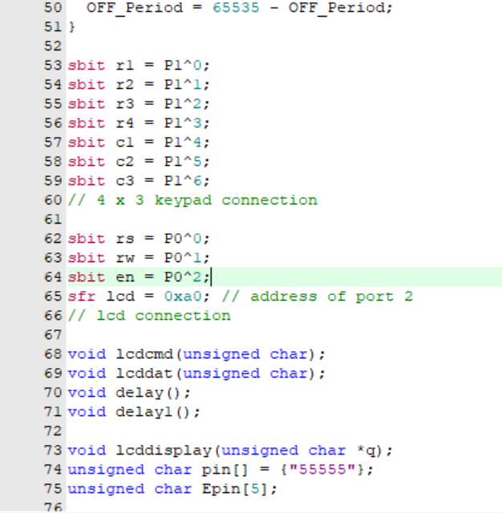
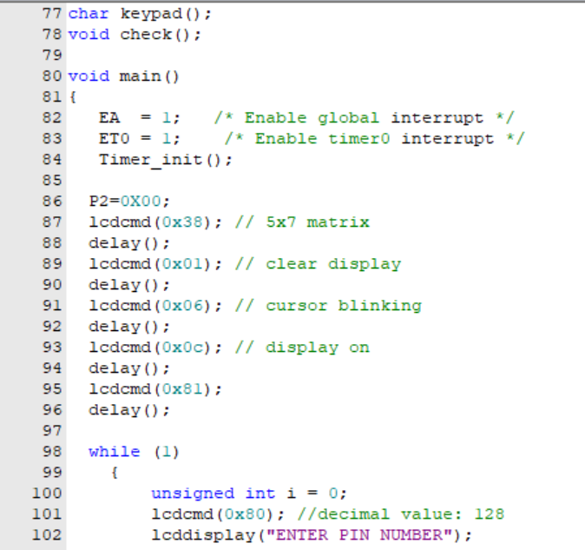
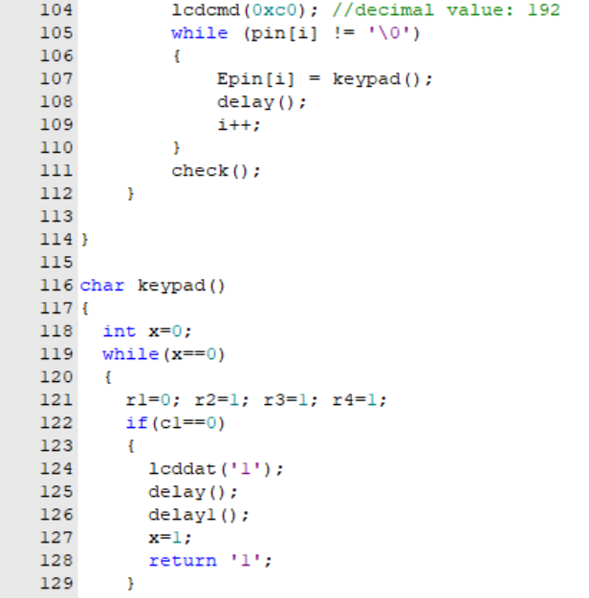
Embedded C Code

Slide 9
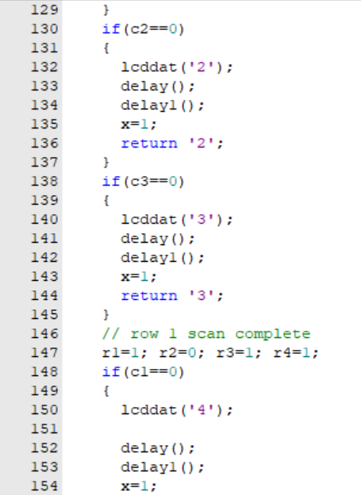
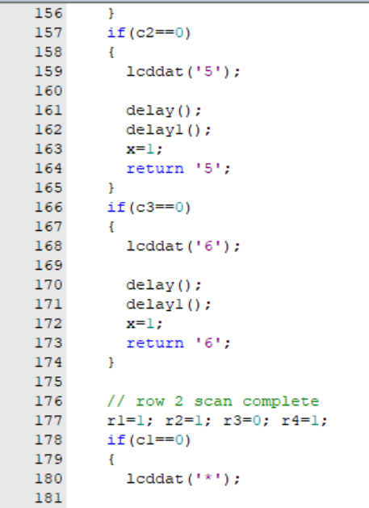
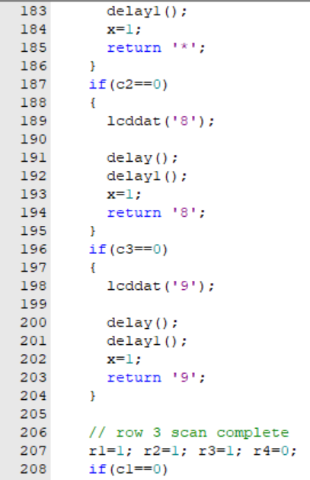
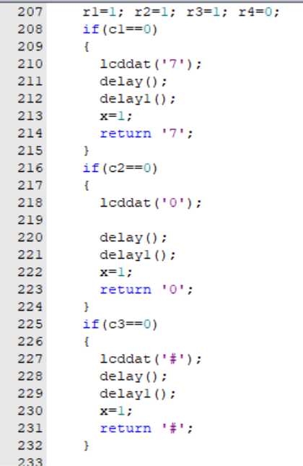
Embedded C Code

Slide 10
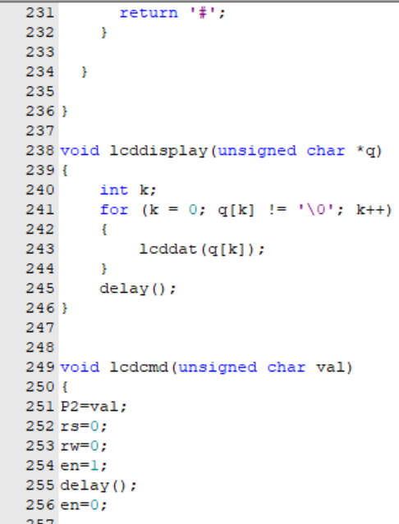
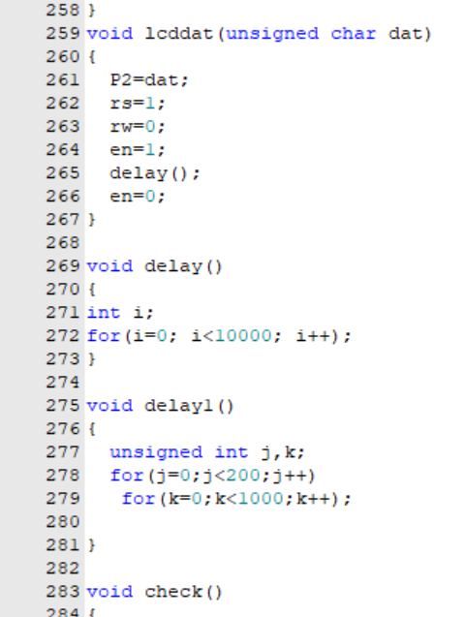
Embedded C Code

Slide 11
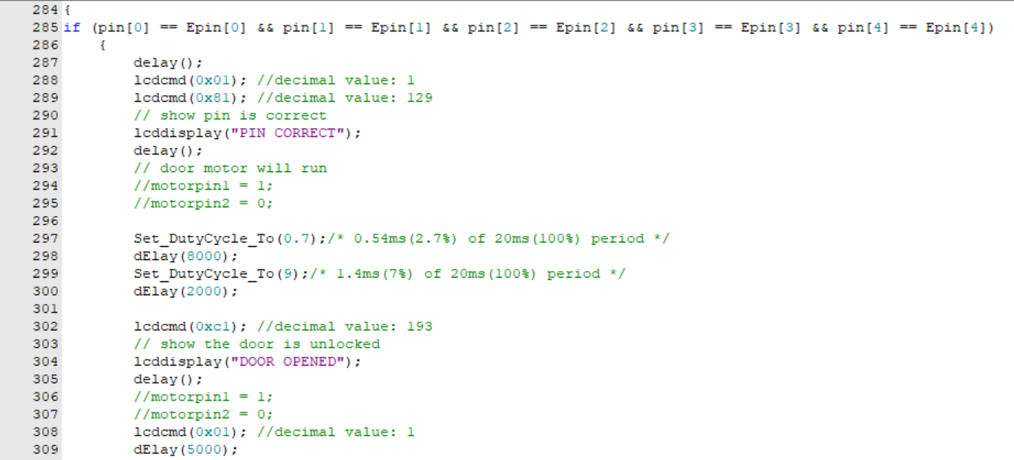
Embedded C Code

Slide 12
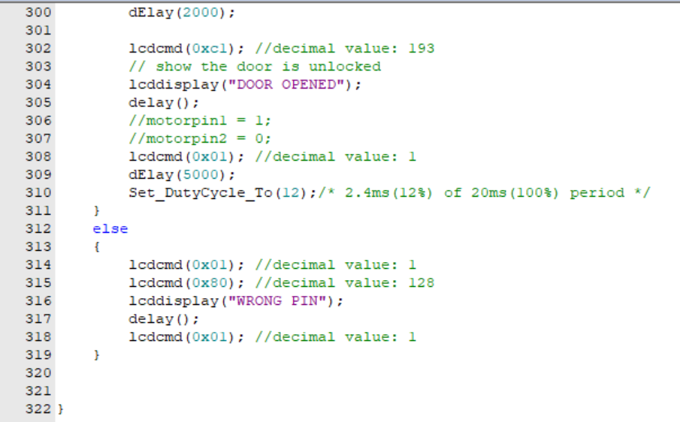
Embedded C Code

Slide 13
TEAM MEMBERS
1.)Eswar Kadali (S20210020271)
2.)N Rohit (S20210020297)
3.)N Sandeep (S20210020300)

Slide 14
Thank You

